Slide 1


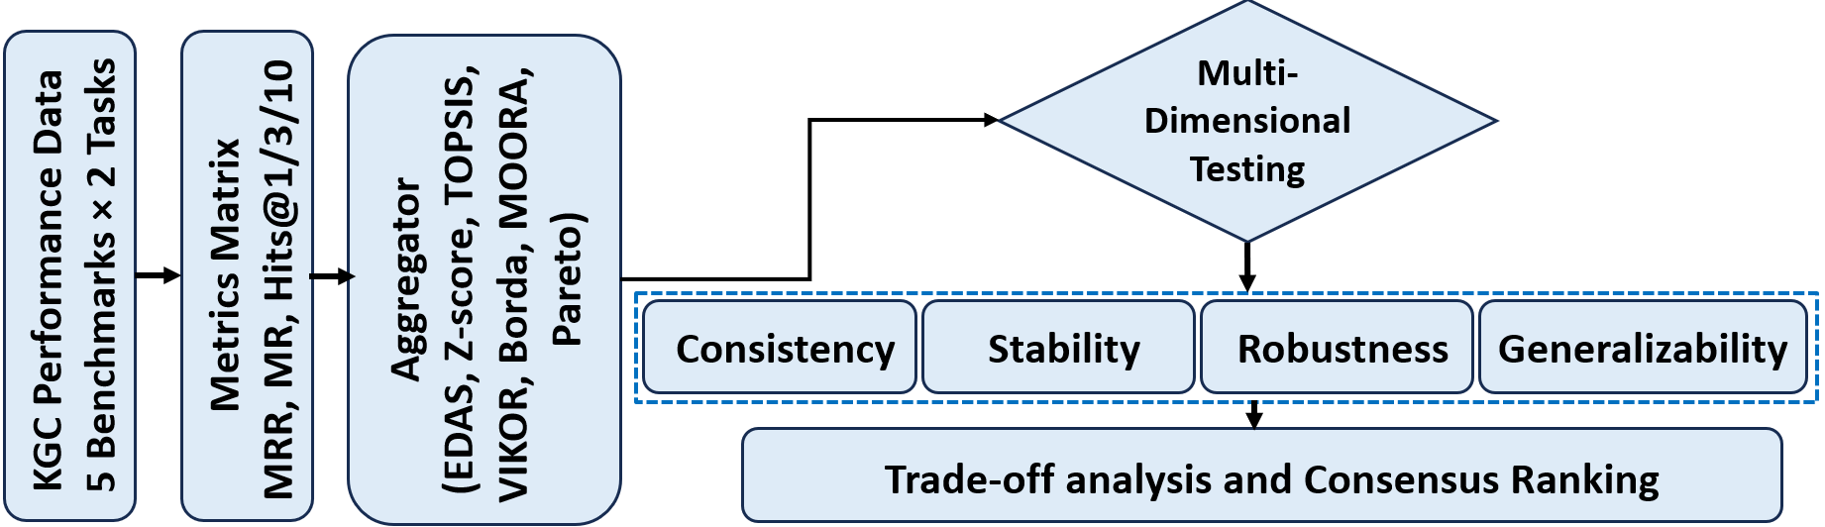
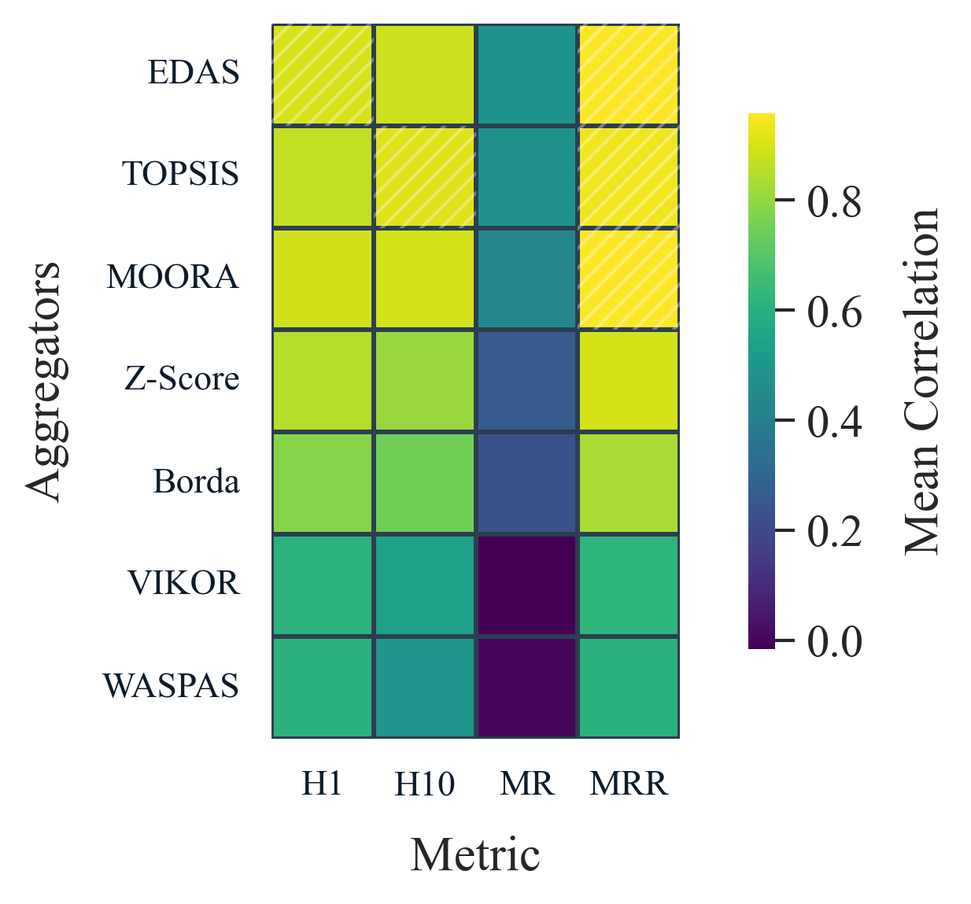
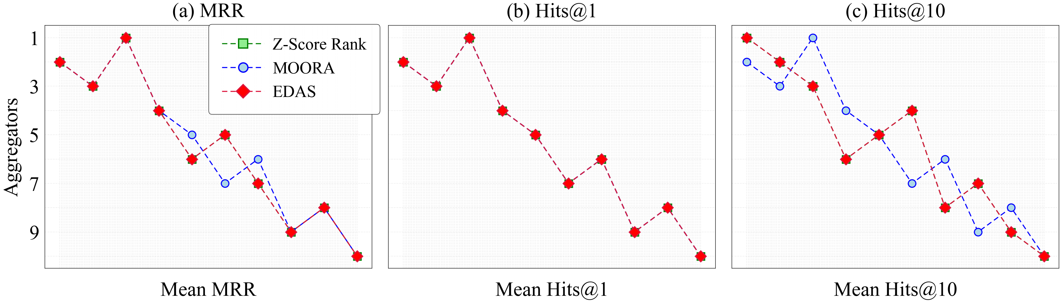
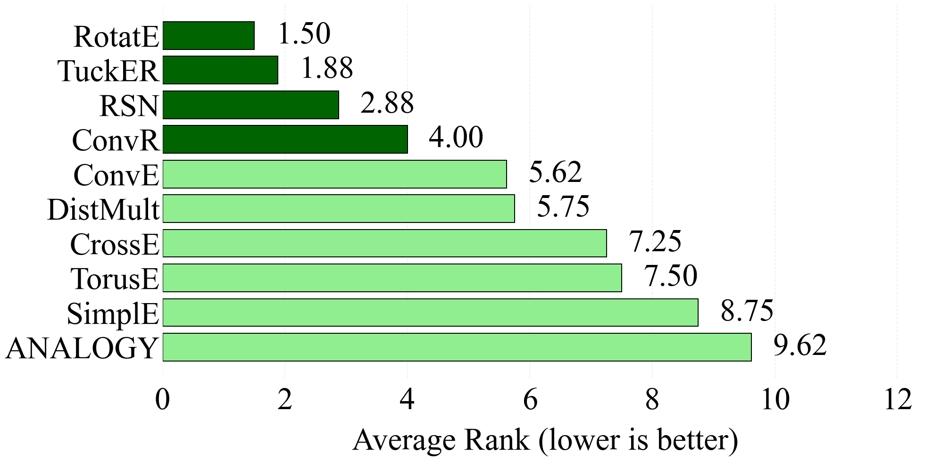
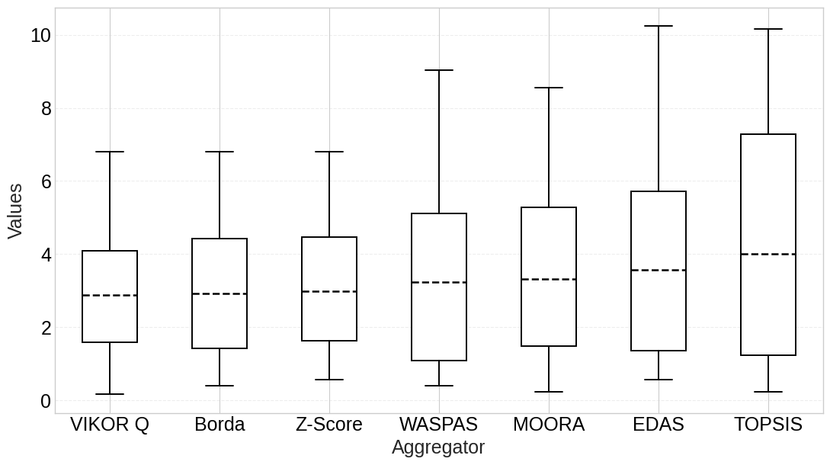
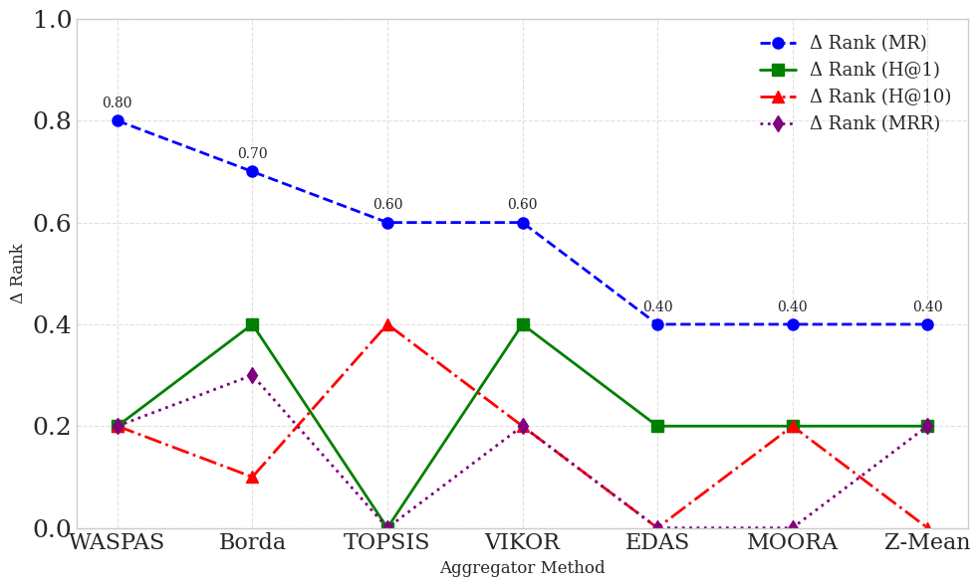
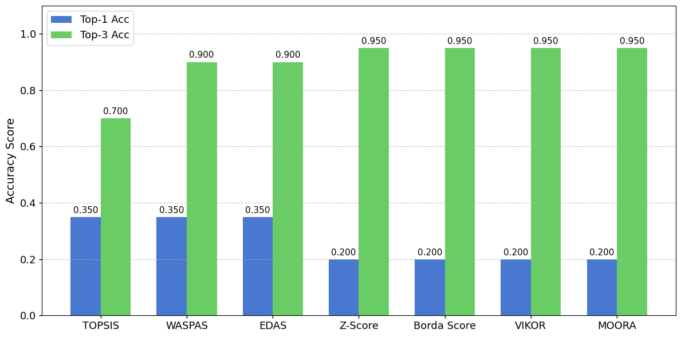
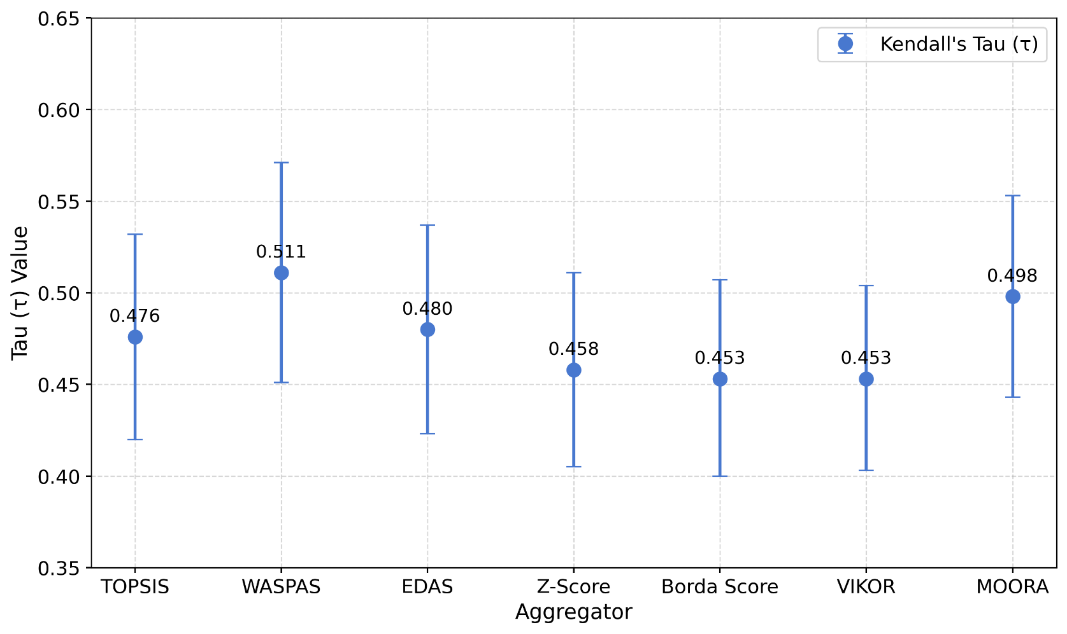
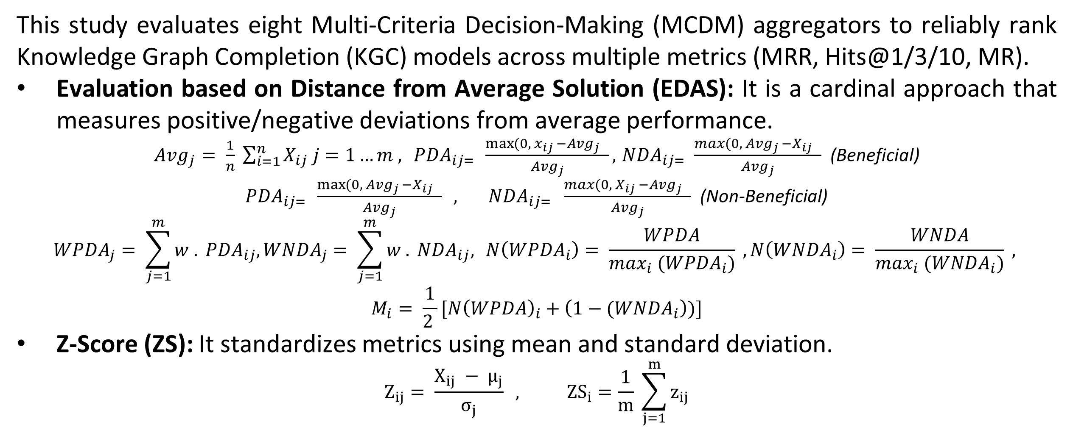
KG-EDAS: A Meta-Metric Framework for Evaluating Knowledge Graph Completion Models
School of Digital Science, Universiti Brunei Darussalam, Brunei Darussalam
Haji Gul (23h1710@ubd.edu.bn), Abdul Ghani Naim, Ajaz Ahmad Bhat (ajaz.bhat@ubd.edu.bn)
Problem Statement
We additionally consider six other established MCDM techniques: TOPSIS, VIKOR, WASPAS, MOORA, Borda Count, and Pareto Frontier to ensure comprehensive coverage of aggregation philosophies (cardinal, ordinal, and set-based).
Many Methods: Contradictory rankings across metrics & datasets prevent top model selection
Many Metric: No consensus exists on which metric (MRR? Hits@1? MR?) should be prioritized
Methodology
Multi-Dimensional Testing
This study evaluates eight Multi-Criteria Decision-Making (MCDM) aggregators to reliably rank Knowledge Graph Completion (KGC) models across multiple metrics (MRR, Hits@1/3/10, MR).
Evaluation based on Distance from Average Solution (EDAS): It is a cardinal approach that measures positive/negative deviations from average performance.
${Avg}_{j}= \frac{1}{n} \sum_{i=1}^{n}{X_{ij} j=1…m ,} {PDA}_{ij= } \frac{\max{(0, x_{ij} −{Avg}_{j} } }{{Avg}_{j}}, { NDA}_{ij= } \frac{\max{(0, {Avg}_{j} −X_{ij} } }{{Avg}_{j}}$ (Beneficial)
${PDA}_{ij= } \frac{\max{(0, {Avg}_{j} −X_{ij} } }{{Avg}_{j}} , { NDA}_{ij= } \frac{\max{(0, X_{ij} −{Avg}_{j} } }{{Avg}_{j}}$ (Non-Beneficial)
$${WPDA}_{j}= \sum_{j=1}^{m}{{w . PDA}_{ij},}{WNDA}_{j}= \sum_{j=1}^{m}{{w . NDA}_{ij},} N\left({WPDA}_{i}\right)= \frac{WPDA}{\max_{i} ({WPDA}_{i})} , N\left({WNDA}_{i}\right)= \frac{WNDA}{\max_{i} ({WNDA}_{i})} ,$$
$$M_{i}= \frac{1}{2 }[{N\left(WPDA\right)}_{i}+\left(1−{(WNDA}_{i}\right))]$$
Z-Score (ZS): It standardizes metrics using mean and standard deviation.
$$Z_{ij}= \frac{X_{ij} − µ_{j}}{σ_{j}} , {ZS}_{i}=\frac{1}{m} \sum_{j=1}^{m}{z_{ij}}$$
This pairing enables a principled comparison across four key components:
Consistency: Alignment with base metrics (τ, r, ρ correlation)
Stability: Cross-dataset ranking variance
Robustness: Sensitivity to metric removal (leave-one-out)
Generalizability: Performance on unseen benchmarks.
Table 1: Link Prediction Results
Fig 1: Methodology Diagram
 | FB15k |  |  |  | WN18 |  |  |  | FB15k-237 |  |  |  | WN18RR |  |  |  | YAGO3-10
Models | MR | MRR | H@1 | H@10 | MR | MRR | H@1 | H@10 | MR | MRR | H@1 | H@10 | MR | MRR | H@1 | H@10 | MR | MRR | H@1 | H@10
RotatE | 42 | 0.791 | 0.739 | 0.881 | 274 | 0.949 | 0.943 | 0.96 | 178 | 0.336 | 0.238 | 0.531 | 3318 | 0.475 | 0.426 | 0.573 | 1827 | 0.498 | 0.405 | 0.671
TuckER | 39 | 0.788 | 0.729 | 0.889 | 510 | 0.951 | 0.946 | 0.958 | 162 | 0.352 | 0.259 | 0.536 | 6239 | 0.459 | 0.43 | 0.514 | 2417 | 0.544 | 0.466 | 0.681
RSN | 70 | 0.773 | 0.706 | 0.886 | 471 | 0.95 | 0.946 | 0.959 | 251 | 0.346 | 0.256 | 0.526 | 5646 | 0.467 | 0.437 | 0.527 | 2582 | 0.527 | 0.446 | 0.673
ConvR | 51 | 0.777 | 0.723 | 0.87 | 346 | 0.928 | 0.912 | 0.951 | 248 | 0.28 | 0.198 | 0.444 | 4210 | 0.395 | 0.346 | 0.483 | 1339 | 0.511 | 0.427 | 0.664
Results
Test 1: Consistency Analysis
EDAS and TOPSIS show the highest overall alignment with standard metrics (~0.6–0.8 with H1, H10, MR, MRR).
VIKOR and WASPAS lowest correlated alignment.
Rotate achieved the top average ranking performance (average rank 1.50).
Fig 4: Consensus Average Ranking
Fig 2: Variance Distributions Across Aggregators
Fig 3: Correlation Among some Aggregators and Metrics
Fig 2: Average Ranking performance
Test 2: Stability Analysis
VIKOR Q and Borda are most stable ranking (mean variance 2.88 and 2.912).
TOPSIS exhibits the highest instability (mean variance 4.016).
Test 3: Robustness Analysis
MR is Higher disruptive metric in the robustness analysis.
Baseline and ablated rankings correlation (> 0.90, MRR, H@1/1-removed)
Fig 5: Distributions Variance values
Fig 6: Robustness: MR most Disruptive Removal
Test 4: Generalization Analysis
TOPSIS and WASPAS top-1 accuracy (0.35) higher than others. While Borda and Z-score top-3 accuracy (0.95).
Fig 7: Generalization Top-1 and 3 Accuracy
Fig 8: (τ) with 95% CI across MCDM Aggregators
Conclusion
(1) Trade-offs exist. No single aggregator is best for all evaluation goals. (2) Use EDAS or Z-Score for robust, consistent overall rankings.
(3) Borda Count is best for stable rankings across datasets., (4) Consensus bests: RotatE/TuckER (relation), MuCo-KGC/KICGPT (tail).
(5) Model stability varies greatly (e.g., RSN stable, DistMult volatile).

